Slide 1

CBC paddings attacks
Online Cryptography Course Dan Boneh
Authenticated Encryption

Slide 2
Recap
Authenticated encryption: CPA security + ciphertext integrity
Confidentiality in presence of active adversary
Prevents chosen-ciphertext attacks
Limitation: cannot help bad implementations … (this segment)
Authenticated encryption modes:
Standards: GCM, CCM, EAX
General construction: encrypt-then-MAC

Slide 3
The TLS record protocol (CBC encryption)
Decryption: dec(k_{b⇾s} , record, ctr_{b⇾s} ) :
step 1: CBC decrypt record using k_{enc}
step 2: check pad format: abort if invalid
step 3: check tag on [ ++ctr_{b⇾s} ll header ll data]
abort if invalid
data
type ll ver ll len
Two types of error:
padding error
MAC error
tag
pad

Slide 4
Padding oracle
Suppose attacker can differentiate the two errors (pad error, MAC error):
⇒ Padding oracle: attacker submits ciphertext and learns if last bytes of plaintext are a valid pad
data
type ll ver ll len
Nice example of a chosen ciphertext attack
tag
pad

Slide 5
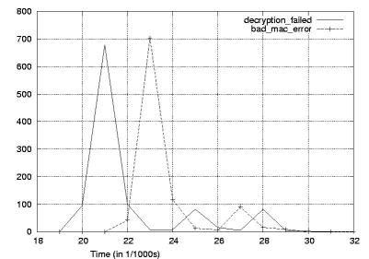
Padding oracle via timing OpenSSL
Credit: Brice Canvel
(fixed in OpenSSL 0.9.7a)
In older TLS 1.0: padding oracle due to different alert messages.

Slide 6
Using a padding oracle (CBC encryption)
Attacker has ciphertext c = (c[0], c[1], c[2]) and it wants m[1]
IV
c[0]
c[1]
c[2]
D(k,⋅)
D(k,⋅)
D(k,⋅)
⊕
⊕
⊕
m[0]
m[1]
m[2] ll pad

Slide 7
Using a padding oracle (CBC encryption)
step 1: let g be a guess for the last byte of m[1]
IV
c[0]
c[1]
⨁ g ⨁ 0x01
D(k,⋅)
D(k,⋅)
= last-byte ⨁ g ⨁ 0x01
⊕
⊕
if last-byte = g: valid pad
otherwise: invalid pad
m[0]
m[1]

Slide 8
Using a padding oracle (CBC encryption)
Attack: submit ( IV, c’[0], c[1] ) to padding oracle
⇒ attacker learns if last-byte = g
Repeat with g = 0,1, …, 255 to learn last byte of m[1]
Then use a (02, 02) pad to learn the next byte and so on …

Slide 9
IMAP over TLS
Problem: TLS renegotiates key when an invalid record is received
Enter IMAP over TLS: (protocol for reading email)
Every five minutes client sends login message to server:
LOGIN "username” "password”
Exact same attack works, despite new keys
⇒ recovers password in a few hours.
Notes:
IMAP gives attacker new ciphertexts to play with, so changing keys doesn’t help.

Slide 10
Lesson
1. Encrypt-then-MAC would completely avoid this problem:
MAC is checked first and ciphertext discarded if invalid
2. MAC-then-CBC provides A.E., but padding oracle destroys it

Slide 11
Will this attack work if TLS used counter mode instead of CBC?
(i.e. use MAC-then-CTR )
Yes, padding oracles affect all encryption schemes
It depends on what block cipher is used
No, counter mode need not use padding

Slide 12
End of Segment

